Slide 1


Windows 10
Modern Device Management
Doug Wilson
@ManageDoug | Microsoft MVP EM+S
dougw@nowmicro.com
Solutions and Product Manager, Now Micro

Slide 2
Agenda
My Community thoughts
About Now Micro
What is Modern Management?
Getting ready for Microsoft Endpoint Manager (MEM)
  Configure Azure and MEM for device management
  Microsoft Store for Education
Deploying and Provisioning
  Configuring Autopilot
  Configuring Compliance
  Setting up Configuration Profiles…. there are a lot of these…
  Endpoint Protection and PowerShell
Maintaining
  Updates, Reporting
Some Basics in Troubleshooting

Slide 3

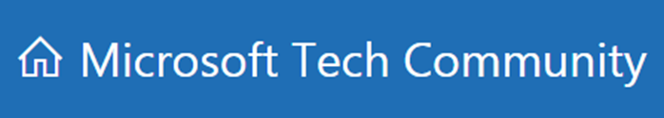
Get Invovled
Join or Start your local user group
Participate in forums
  Technet
  MyItForum
  Microsoft Tech Community
  Etc…
Get on Twitter
  Not just for celebrities and presidents
Keep a Blog

Slide 4

Device Lifecycle Company
Hardware Reseller (Dell, HP, Lenovo, and more)
OEM (Digital Signage, Kiosks, Appliances)
Professional Services (Systems Management,
Cloud Solutions, Automation)

Slide 5
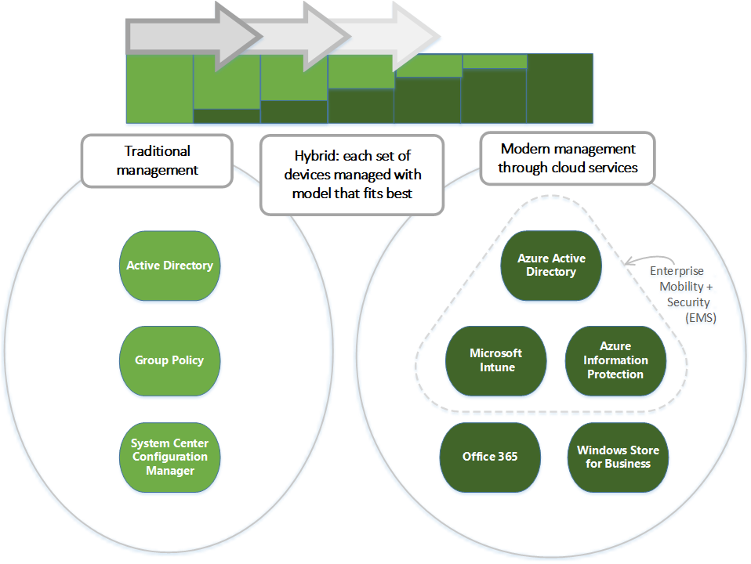

Slide 6











Azure AD conditional access (Zero Trust)
Azure AD
ADFS
Conditions
Controls
MSA
40TB
Google ID
Employee & Partner
Users and Roles
Allow/block
access
Microsoft Cloud
Android
Session
Risk
iOS
Trusted &
Compliant Devices
Machine
learning
3
MacOS
Limited
access
Microsoft
Cloud App Security
Windows
Windows
Defender ATP
Require
MFA
Real time
Evaluation
Engine
Cloud SaaS apps
Force
password
reset
Geo-location
Physical &
Virtual Location
******
Corporate
Network
Policies
Effective
policy
Client apps &
Auth Method
Block legacy
authentication
Browser apps
Client apps
On-premises
& web apps
Notes:
Example: If an ADFS user signs in on a Windows machine with Windows Defender ATP we can take into account the health of the account and the device, as well as their location and if they are on the corporate network and what type of app they are trying to access. If they are on the corporate network in their normal office then the data produces a low risk score. The effective policy is to all access to the app. If, however, the person was logging in from a location across the world (in a short amount of time – impossible travel) and/or the Windows Defender ATP finds that the machine has been infected, the access can be blocked. If the user login and device are healthy, but it was a location they haven’t signed in from before (on a trip or other computer) then the user could be prompted with MFA or have limited access to certain applications.

Slide 7
Why Modern Management?
Windows 10 is in a state of constant updates and upgrades
Wider variety of devices means a larger attack vector
We care about identity protection
We can empower users no matter what device they have to create a more rounded experience
Analytics

Slide 8
Configuring Endpoint Manager for enrollment
Configure Automatic Enrollment
Lock Down Enrollment Status Page
Configure device restrictions
Enrolling Devices
Make sure users are licensed for Intune/Microsoft Endpoint Manager
Endpoint Manager relies heavily on groups in Azure, to assist schools with this, Microsoft has School Data Sync which can utilize your Student Information System.
  https://docs.microsoft.com/en-us/schooldatasync/

Slide 9
Enable Microsoft Store for Education
You need permissions…
educationstore.microsoft.com

Slide 10
Configuring and Provisioning
Compliance Profiles
  Not really remediation, more like just a notice.
  Emails end user and maybe the help desk
Configuration profiles…
  There are so many that we need to just talk through this with demos
  Details on all of them https://docs.microsoft.com/en-us/intune/configuration/device-profiles
PowerShell Scripting
Endpoint Security
  Security Baselines and more

Slide 11
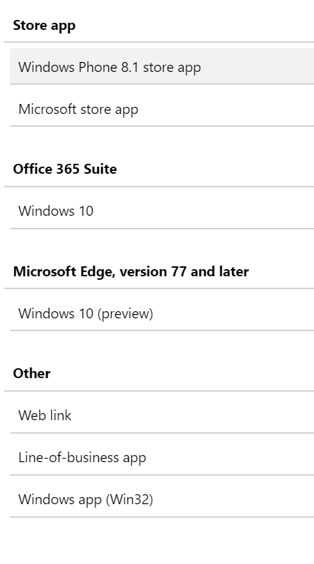
Application Management
For Win32 Applications
  https://docs.microsoft.com/en-us/intune/apps/apps-win32-app-management
  https://github.com/Microsoft/Microsoft-Win32-Content-Prep-Tool

Slide 12
Assisting with large deployments
For large group deployments we can lean on utilities such as Setup School PC’s and Windows Configuration Designer
  https://docs.microsoft.com/en-us/education/windows/use-set-up-school-pcs-app
  https://docs.microsoft.com/en-us/windows/configuration/provisioning-packages/provisioning-packages

Slide 13
Configuring Autopilot
Create Autopilot device profiles
  Create groups to go with these profiles
  Queries:
  All devices enrolled: (device.devicePhysicalIDs -any _ -contains "[ZTDId]")
  By Group ID: (device.devicePhysicalIds -any _ -eq "[OrderID]:AADJ")

Slide 14
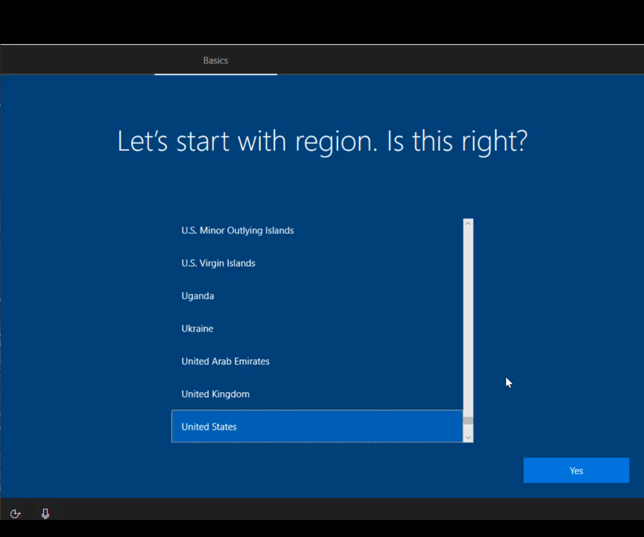

Slide 15
Maintanance…
Managing Windows Updates
Understanding the reporting
How to troubleshoot our devices
    https://docs.microsoft.com/en-us/intune/configuration/troubleshoot-policies-in-microsoft-intune
    https://docs.microsoft.com/en-us/intune/configuration/device-profile-troubleshoot
Additional links
  https://docs.microsoft.com/en-us/education/itadmins

Slide 16

Questions and Discussion
Doug Wilson
@ManageDoug
dougw@nowmicro.com
Solutions and Product Manager, Now Micro

